Slide 1
Sales Prediction Project

Slide 2
Introduction and Objectives
The Sales Prediction Project aims to analyze historical sales data and customer behavior to gain valuable insights that can help optimize sales strategies and improve revenue generation.
Dataset: The project utilizes three main datasets - 'train.csv', 'store.csv', and 'sample_submission.csv’.
Objectives:
Explore customer purchasing behavior and analyze sales trends during different periods.
Examine the impact of promotions on sales and customer engagement.
Investigate the relationship between assortment types and sales performance.
Analyze the effect of competitor distance on sales and its relevance for stores in city centers.
Provide actionable recommendations to enhance sales performance based on the insights gained.

Slide 3
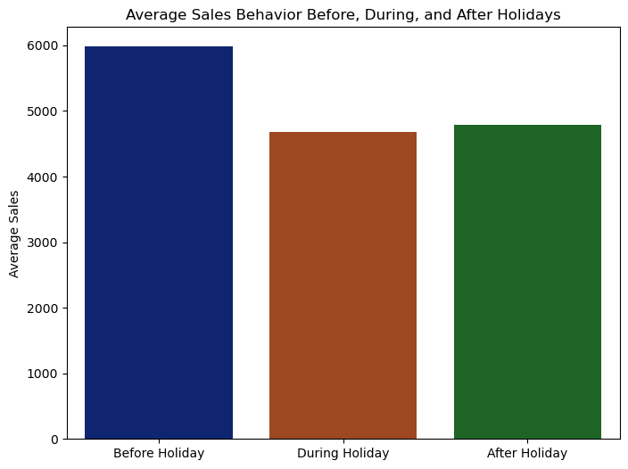
Sales and Customer Behavior Analysis
The analysis of sales behavior before, during, and after holidays reveals interesting insights.
Before the holidays, sales tend to be relatively high. However, during holidays, there is a noticeable decrease in average sales, indicating less consumer spending.
After holidays, sales experience a slight increase, likely due to promotional activities and consumer slightly spending income.

Slide 4
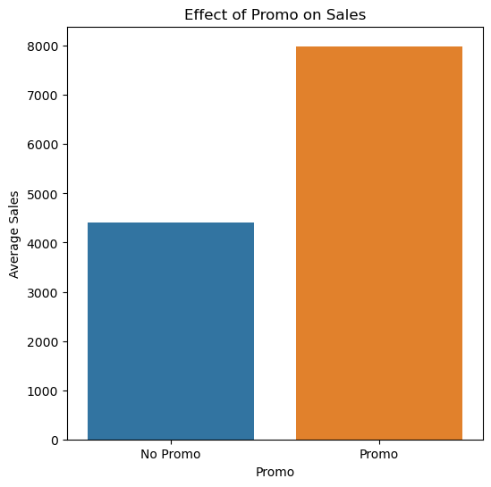
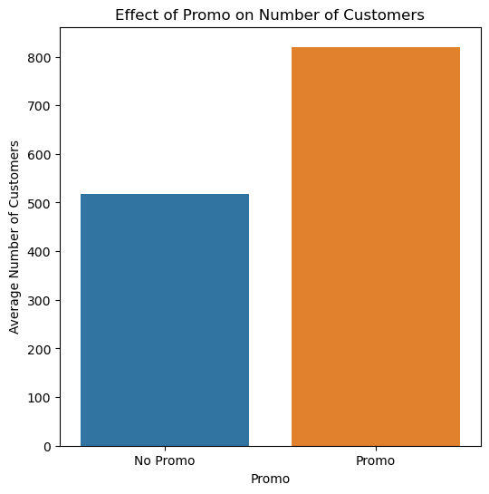
Impact of promos on sales and customer behavior, etc.

Slide 5
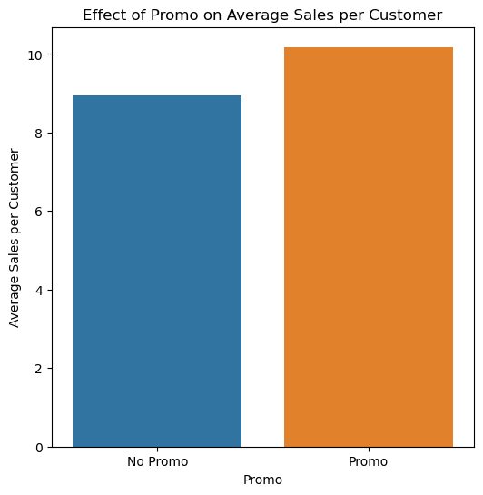
Overall, the analysis indicates that promotions play a crucial
role in driving both sales and customer engagement. They not
only bring in new customers but also encourage existing
customers to spend more, leading to higher revenue for the
business.

Slide 6
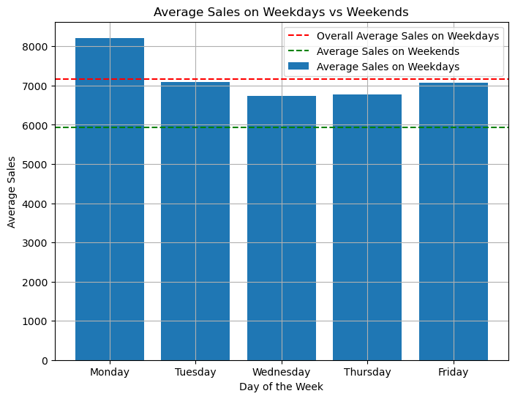
Average Sales on Weekdays VS Weekends
The bar plot visualizes the average sales on
weekdays for each day of the week (Monday to Friday).
The red dashed line represents the overall average sales on weekdays, which is approximately 7174.46.
The green dashed line represents the average sales on weekends, which is approximately 5932.02.
In conclusion, based on this visualization, it appears that the stores experience higher sales on weekdays (particularly on Monday, Tuesday, and Friday) compared to weekends.

Slide 7
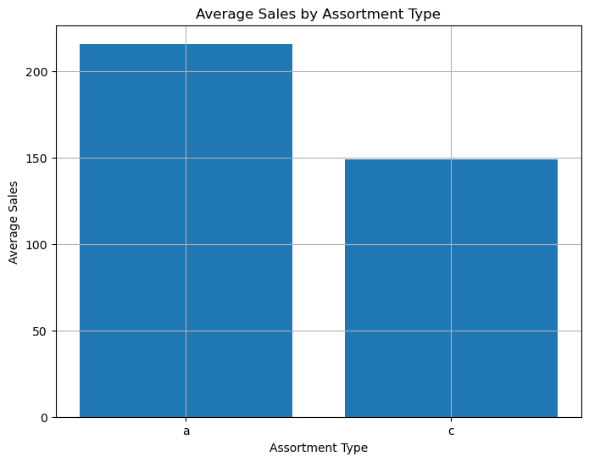
The average sales for different assortment types.
The bar plot above shows the comparison of average sales for two assortment types: 'a' and 'c'.
Assortment type 'a' (indicating a larger assortment) has an average sales value of 216, while assortment type 'c' (indicating a smaller assortment) has an average sales value of 149.
It suggests that stores with a larger assortment type ('a') tend to have higher average sales compared to stores with a smaller assortment type ('c').

Slide 8
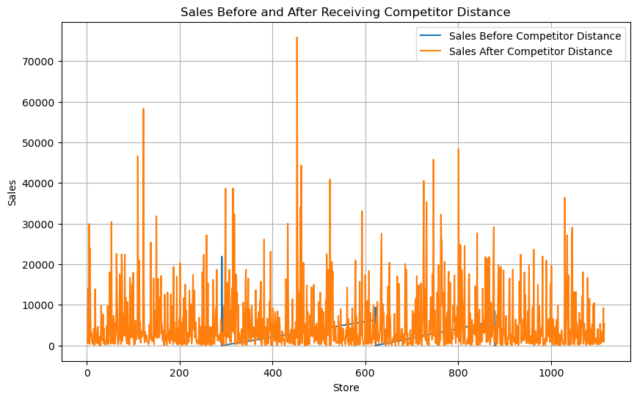
Sales before & after Receiving competitor distance.
The competitor distance analysis reveals that there are some stores initially missing competitor distance values. However, later on, these stores receive competitor distance values
This suggests that competitor distance plays a role in influencing store sales, and stores with closer competitors may experience more competitive pressure and impact on their sales performance.

